Slide 1
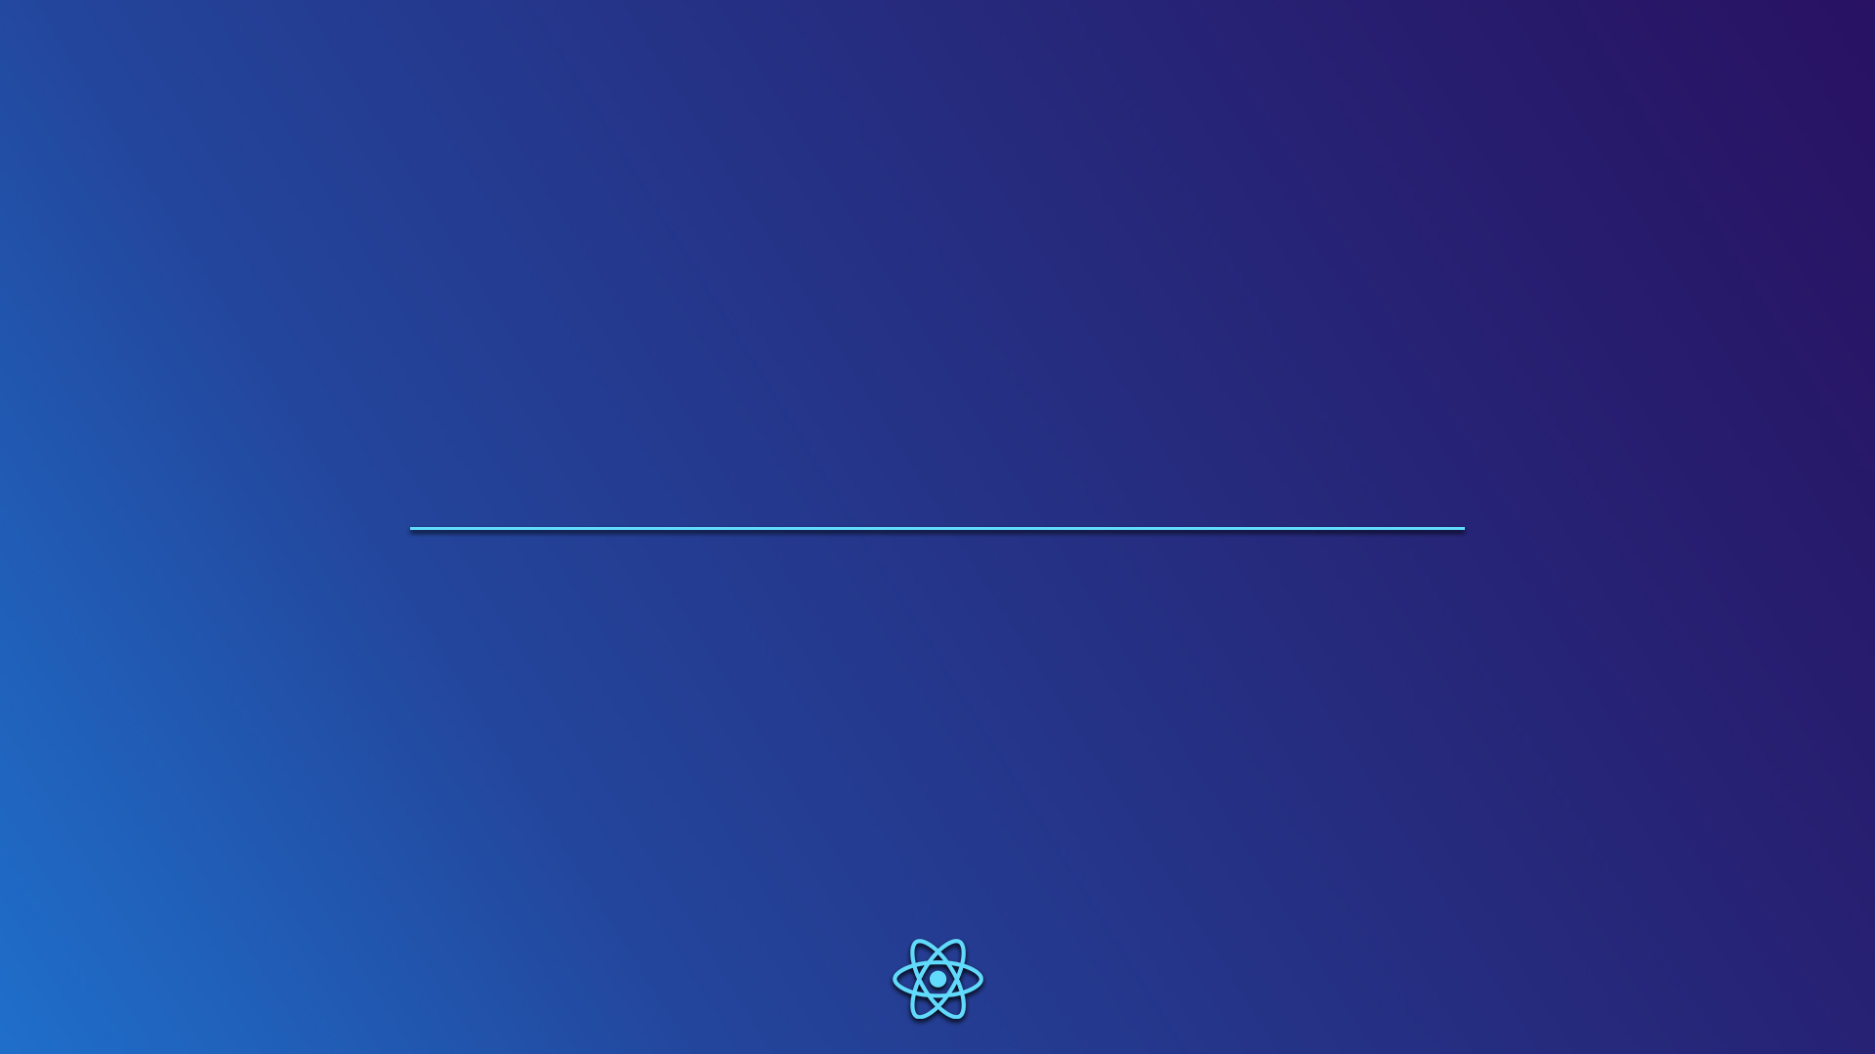
React
JavaScript library
Presentation by Diogo Correia

Slide 2
What is React?
React is a JavaScript library for front-end development.
React presents the following features:
Declarative view
Components
User Interface
React makes it easier to create UIs through it's declarative programming views, in a way that you have to say what you want, not how you want it.
React uses a technique of dividing the code into encapsulated components, making use of Object-oriented Programming with JavaScript's classes.
Each component render a piece of HTML code, with actual HTML syntax, avoiding the painful functions from the document, in JavaScript, to manipulate elements.

Slide 3
How does React work?
Setup
To setup React locally, it is used NodeJS package manager (NPM).
By running the following command
npx create-react-app my-app
you create a development environment.
When inside the app directory, the app will be running on localhost after running the command
npm start
The .js files should start with
import React from 'react';
import ReactDOM from 'react-dom';
import './index.css';
in order to gain access to the necessary classes and methods.

Slide 4
How does React work?
Writing code
As stated previously, React code is based on components .
can be seen as a section of the interface;
can have children components, which can receive information from its parent through props;
the information in each component is stored in states.
components
The document is rendered a first time using ReactDOM.render and passing the main component which calls a method that returns the page structure. To update the interface within each component, this method must be called again with only the elements that are being updated (i.e.: just a <button></button>).

Slide 5
How does React work?
Writing code
class Board extends React.Component {
constructor(props) {
...
}
renderSquare(i) {
return (
<Square
value={this.state.squares[i]}
onClick= {() => this.handleClick(i)}
/>
);
}
}
class Square extends React.Component {
render() { // renders specific elements
return (
<button
className="square"
onClick={() => this.props.onClick()}
>
{this.props.value}
</button>
);
}
}

Slide 6
Why React?
React makes UI updates a much easier and more intuitive job.

Slide 7
Code examples

